Slide 1
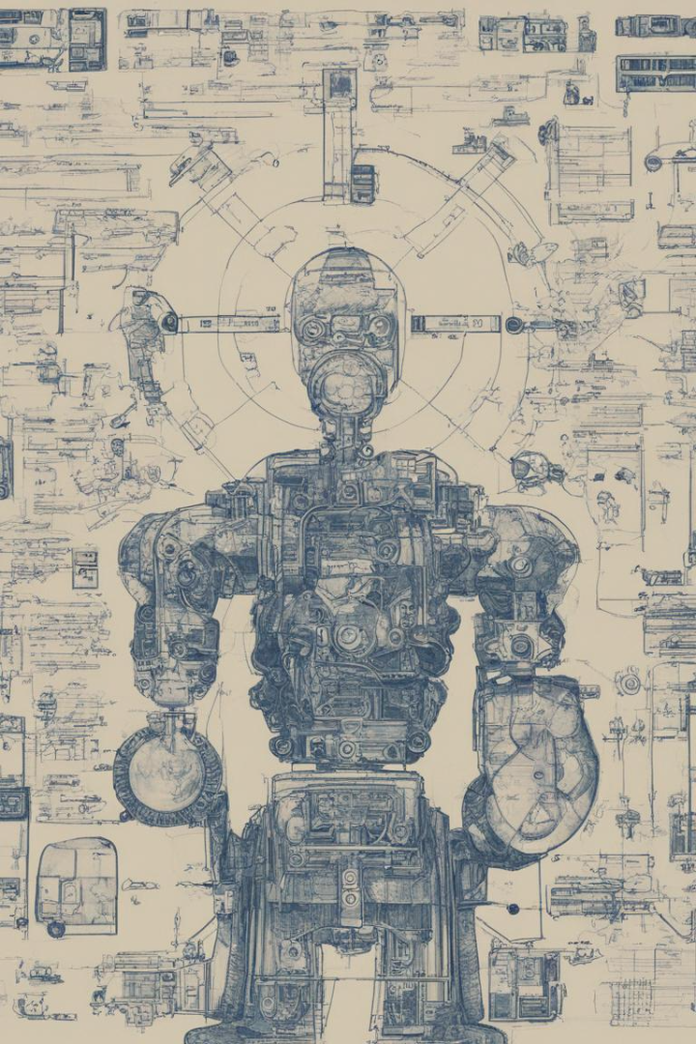

Machine Learning-Based URL Filtering Prototype
Design, Implementation, and Functionality
by i200983 Fahad Kamran

Slide 2

Introduction
Machine learning-based URL filtering plays a crucial role in ensuring user safety by classifying URLs into different categories. This prototype aims to achieve just that.

Slide 3

Literature Review
1
State-of-the-Art Overview
An overview of the current state-of-the-art in machine learning-based URL filtering and its importance.
2
Challenges Faced
Lack of Data in the original ICSX-2016 Dataset

Slide 4
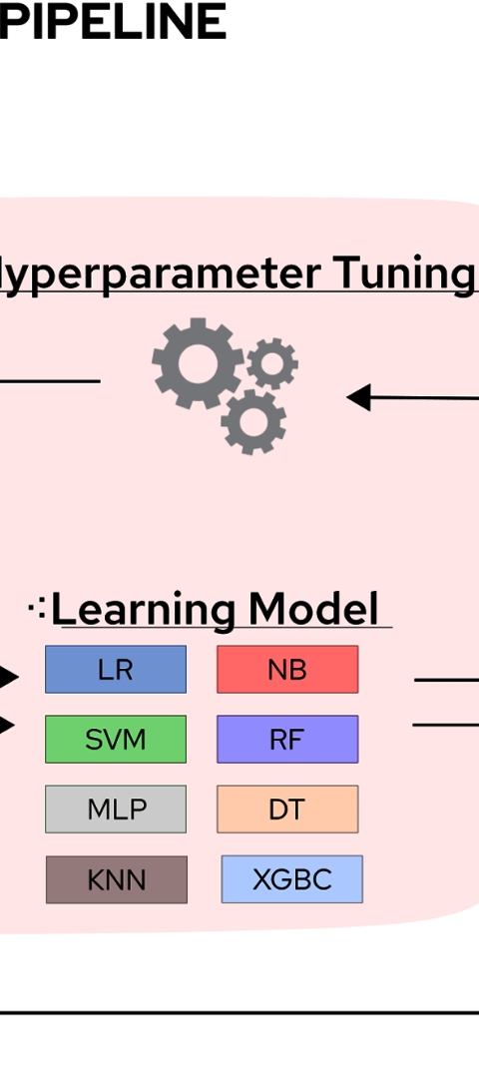
Dataset Selection
ISCX-URL-2016 Dataset
Initial use of the ISCX-URL-2016 dataset with the transition to neural network models due to compatibility issues. (about 165,000 Records)
Additional Datasets
Inclusion of additional datasets: Kaggle's malicious URL dataset (about 650,000 records) and Mendeley Data Dataset (about 2 million records) for enhanced model training.

Slide 5
Neural Network Training
Iterative Training
Memory Optimizations
Discussion on the iterative training process with fine-tuning and architecture enhancements.
Optimizations for memory issues, including larger batch sizes and refined feature counts.

Slide 6

Flask Application Integration
1
Development
Creation of a Flask application to seamlessly integrate the model with the front-end HTML page.
2
User Input
Allowing users to enter the URL for real-time classification.

Slide 7
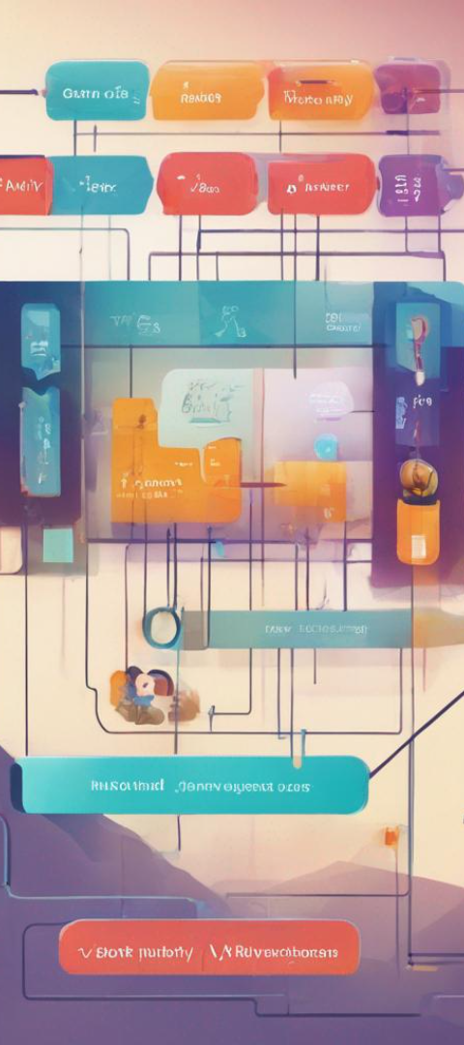


Prototype Functionality
User Input
Details on user input and the efficient real-time classification for immediate feedback.
Efficiency
Demonstration of the neural network's efficiency for quick decision-making.

Slide 8
Evaluation
Training Accuracy
Validation Accuracy
Test Accuracy
98%
96%
95%

Slide 9


Conclusion
Integration Success so avoided further dataset modifications

Slide 10

Future Directions
1
Model Refinement
2
Addressing Misclassifications
Continuous refinement of the model to enhance accuracy and performance.
Strategies to address common misclassifications for improved user safety.

Slide 11
References
Brunswick, U. o. (2016). ISCX-URL-2016 Dataset. Retrieved from unb.ca: https://www.unb.ca/cic/datasets/url-2016.html
Ma, J., Saul, L., Savage, S., & Voelker, G. (n.d.). URL Reputation Dataset. Retrieved from archive.ics.uci.edu: https://archive.ics.uci.edu/dataset/187/url+reputation
Rathore, M. (2016, September 26). Detecting-Malicious-URLs-Using-Lexical-Analysis. Retrieved from semanticscholar.org: https://www.semanticscholar.org/paper/Detecting-Malicious-URLs-Using-Lexical-Analysis-Mamun-Rathore/01bb00b24fb2bcf1d11748d0c39ba60367b4c264
Saqib, M. N. (2022). URL Filtering by Using Machine Learning. Retrieved from paper.ijcsns.org: chrome-extension://efaidnbmnnnibpcajpcglclefindmkaj/http://paper.ijcsns.org/07_book/202208/20220834.pdf
SIDDHARTHA, M. (2021). Malicious URL Dataset. Retrieved from Kaggle: https://www.kaggle.com/datasets/sid321axn/malicious-urls-dataset/
Singh, A. (2020, May 2). Dataset of Malicious and Benign Webpages. Retrieved from Mendeley Data: https://data.mendeley.com/datasets/gdx3pkwp47/2
Singh, A. (2020, October). Malicious and Benign Webpages Dataset Article. Retrieved from Science Direct: https://www.sciencedirect.com/science/article/pii/S2352340920311987

Slide 12

Thank You
Any Questions?

